Slide 1
Income level prediction
Xin Tang
DSC 630
Professor Andrew Hua
Bellevue University

Slide 2
Problem Statement
Income information is important to make many decisions.
Income provides economic resources that shape many personal choices. It is also imperative for companies to know true income information to target the suitable consumer groups and mitigate the financial risk in situations like credit card or loan application, even buying a house.
Everybody lies (Seth, 2017)
For various reasons, consumers often unable or unwilling to provide their true income information. which makes it difficult for enterprises to just rely on the self-reported data.
A more objective way is needed to get the true income level information.
Goal is to predict the customer income level (high vs low) using objective indirect data, which are less likely to be manipulated.
Modeling

Slide 3



Methods
Through predictive modeling, correlated historical data can be used to build a model, which can predict the interested outcomes.
Predict customer’s income level into 2 groups (classification)
Using CRISP-DM process (Cross-Industry Standard Process for Data Mining)
Using python as modeling language
Using common data modeling packages (like SCIKIT-LEARN).
Data
Data cleaning and transformation
Modeling

Slide 4
Data set
This dataset originates from the 1994 Census Bureau database and was curated by Ronny Kohavi and Barry Becker.
Collected information from 31934 individuals, who are old than 16 years, with AGI >$100. with work hour > 0.
The supervised data classified individuals into 2 groups, with income exceed $50K (>) or no more than $50K (<=) in 1994. which is worth $100.6K today (per CPI inflation calculator). So, it is a still a good threshold for today.
The dataset has mixed numerical and text information
Information collected per individual:
Age: in years, numerical
Work class: private sector, government etc. text
Education level in highest grade. text
Education length: in years numerical
Marital status: text
Occupation: text
Relationship: with kid, not in family etc. text
Race: text
Sex: Male or female: text
Native country: text
Fnlwgt: final weight, an estimation of the number of people each observation represents in the population. numerical

Slide 5
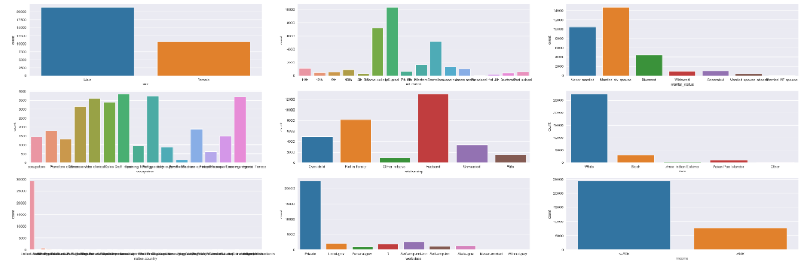
Data Visualization
White is the dominating race
High income to low-income ratio is 0.32: 1
Modeling
Sex
Education
Marital status
Occupation
Relationship
Race
Native country
Work class
income

Slide 6
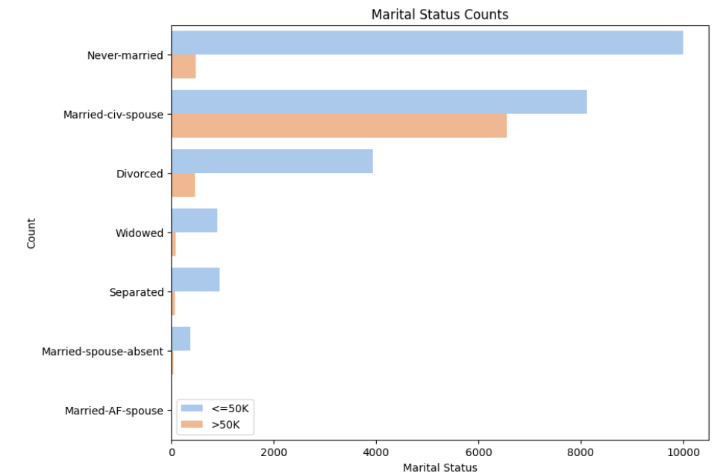
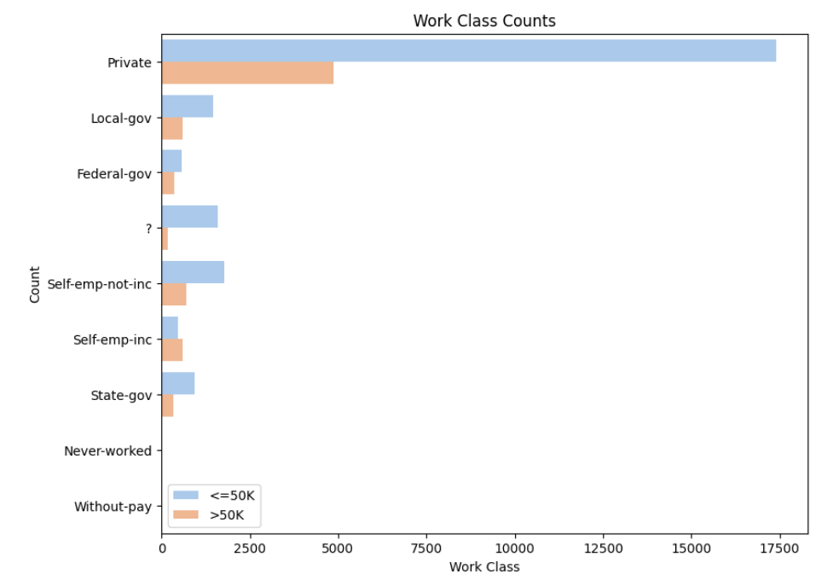
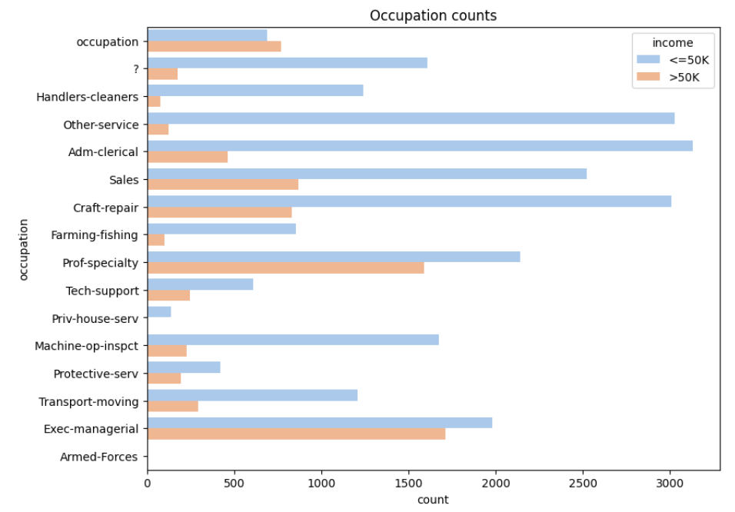
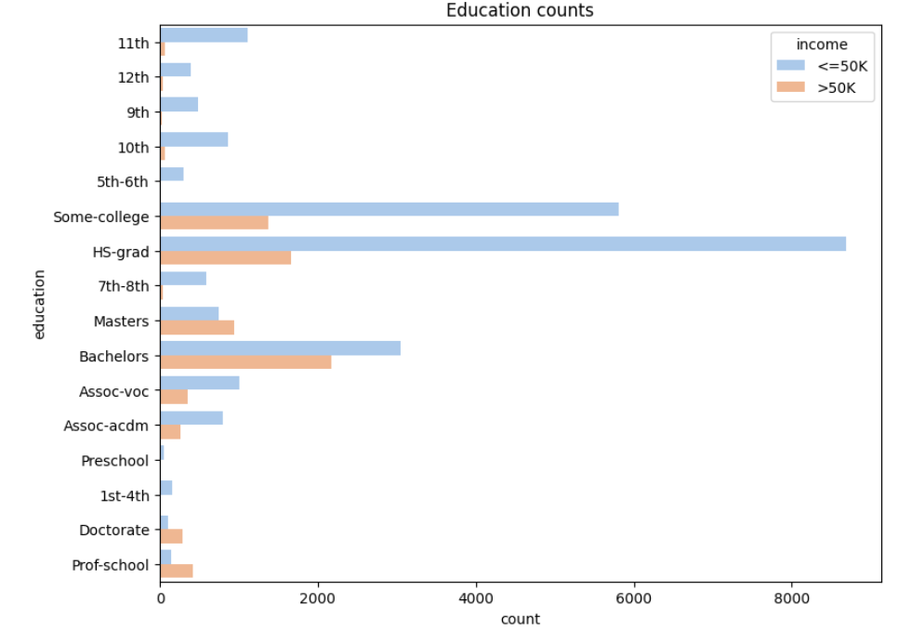
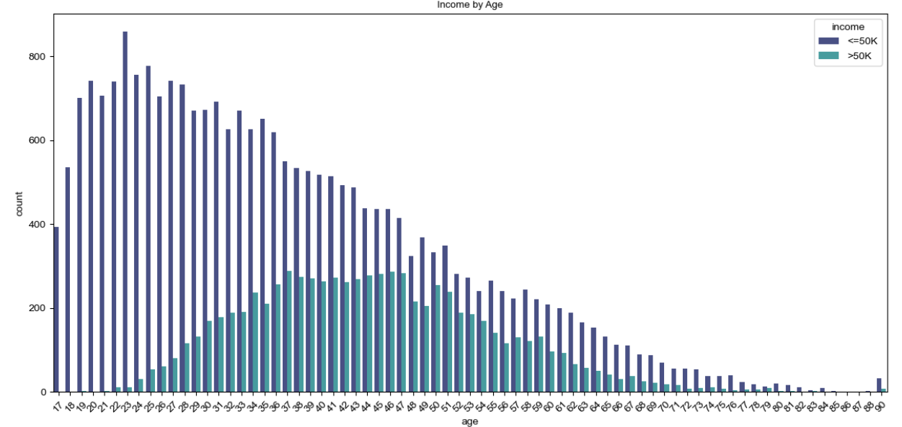
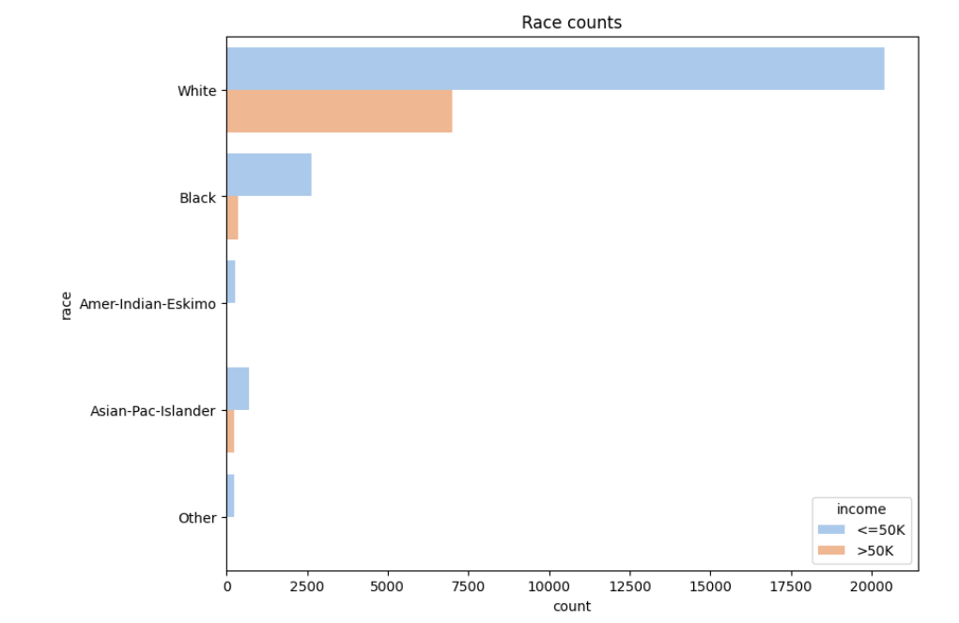
Data Visualization
Marital status, work class and Age are driving income difference

Slide 7
Data Cleaning and feature engineering
Data cleaning:
”?” and meaningless answer ( answer o occupation is occupation) are converted to NA.
NA is less than 1% of all answers, so NA removed
Education and education length number are similar thing so keep only education length.
fnlwgt is also removed since it is not relevant to any other variables or income.
Feature engineering:
Convert income to 0 and 1 (0 is <=$5k and 1 is >$5K).
Convert sex to 0 and 1 (0 is male and 1 is female)
Convert work class to numerical based on its mean income of this class.
Convert all categorical columns (marital status, occupation, relationship, race, native country) to numerical values.
Since income count is not balanced, so use SMOTE to get it balanced for model training
Data is being standardized using standard scaler before train/test split.

Slide 8
Model selections
Models:
This is a classification question, so 3 classification models are selected.
Random Forest classifier
A flexible, easy to use ML algorithm with build in benefit of overfitting avoidance.
Random Forest classifier with hyperparameter tuning.
Buy tuning and select optimal model parameters, it normally yield improved performance.
XGB Classifier
Often has better accuracy and scalable to fit the data size.

Slide 9
Model evaluations
Models need to be evaluated to ensure it is robust and effective.
This is a classification question, so 3 classification models are selected.
Accuracy: Ratio of correctly predicted observation to total observation. Not work well since data is imbalanced.
Precision: Proportion of positive prediction which are correct.
Recall: Proportion of actual positives that are classified correctly.
F-1 Score: a harmonic mean of precision and recall.
 | Random Forest Classifier | RF with tuning | XGB classifier
Accuracy | 86% | 86% | 86%
F-1 score for income >$5K | 0.86 | 0.87 | 0.86
Precision for income >$5K | 0.84 | 0.84 | 0.83
Recall for income >$5K | 0.89 | 0.89 | 0.89
I would recommend random forest classifier with tuned parameters

Slide 10
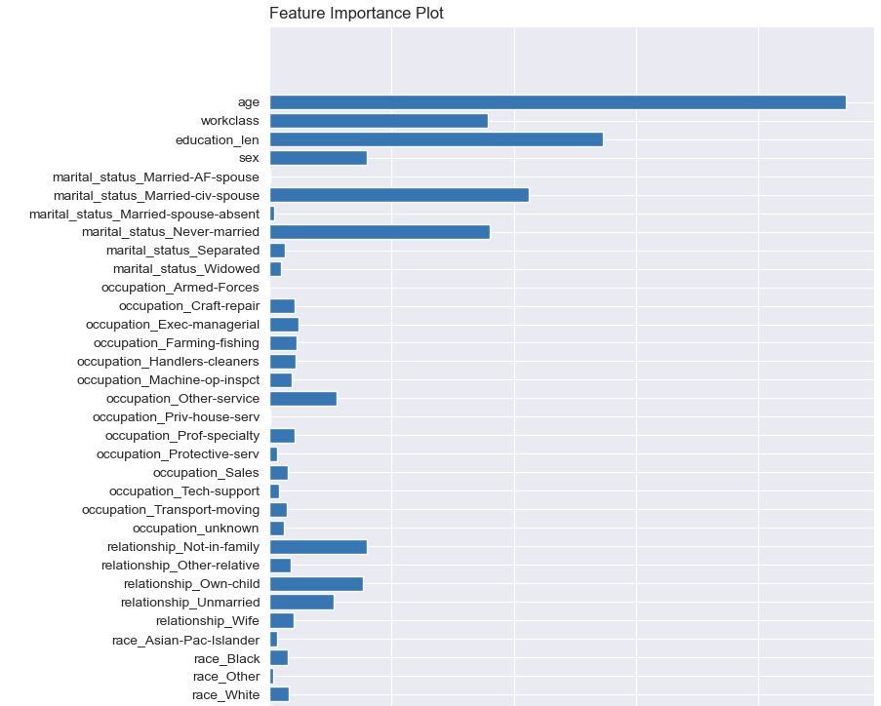
Factors impact income level most
Modeling
Age, Education and Marriage status are the top 3 factors determining income level

Slide 11
Conclusion
This project successfully built a machine learning model, which can classify individual’s income level into high/low group, using indirect objective information.
The model is with 86% accuracy, 89% of classified high income are actual high income individuals.
This method can be used to predict individual’s income level, or cross check if the self-reported income is trustworthy.
Modeling

Slide 12
Recommendations/Next Step
Getting more recent customer data to validate the model.
Gather subject expert input if additional variables need to be considered
Gather expert input on feasibility of the model
ROI (return on investment) study
Develop an implementation plan for executive approval.

Slide 13
Ethical implication
The outcome of the model will help to make decisions which will shape people’s life, so regular monitor and review are recommended.
The success of model is heavily depended on the data selected. Avoid discrimination on data selection.
As society evolves, so are the factors impacting income, continuous improvement of model is suggested.
This model will use a lot of personal information, please be aware of the data leak risk.

Slide 14
References and Acknowledges
Income dataset:
ANAGHA K, P ( Oct. 2023). Adult Income Census, Predict whether income exceeds $50K/yr based on census data, Retrieved June 10, 2024 from https://www.kaggle.com/datasets/anaghakp/adult-income-census/data
Evaluating classification methods:
Brandon Wohlwend (Ju16,2023): Evaluating classification models
https://medium.com/@brandon93.w/machine-learning-evaluating-classification-models-18713af3d764
What is XGBoost and why does it matter?
From Nvidia.com, author unknown
https://www.nvidia.com/en-us/glossary/xgboost/
Thanks for the invaluable input/review from the instructor and classmates:
Professor Andrew Hua (instructor)
Ander Eguluz (classmate)
Krista-fer Knuckey (classmate)

Slide 15
Any Questions?

Slide 16
Video file

Slide 17
Break up

